Slide 1

Battle of Two Neighbourhood's
Coursera Capstone Project

Slide 2
Battle of Two Neighbourhood's
The 2 cities in consideration are :-
Mumbai
Delhi

Slide 3
Business Problem
The business problem in this study assumes that people who would be interested in this study are those who would like to create a projection of potential life and activities in these metro city neighborhoods if the subject moves to live in one of them. The decision to choose one over the other would depend on popular venues in the neighborhoods in each of these metro cities.
Mumbai and Delhi are the two most important metro cities in India. There has been a war for supremacy in terms of quality of life, jobs, education, entertainment and recreational facilities that these cities have to offer to its residents. I attemp to analyze the neighborhoods in each of these two cities and try to understand what is popular in them and what they have to offer to someone who is contemplating to make a choice on seeking a life in either of the metro cities of India.

Slide 4
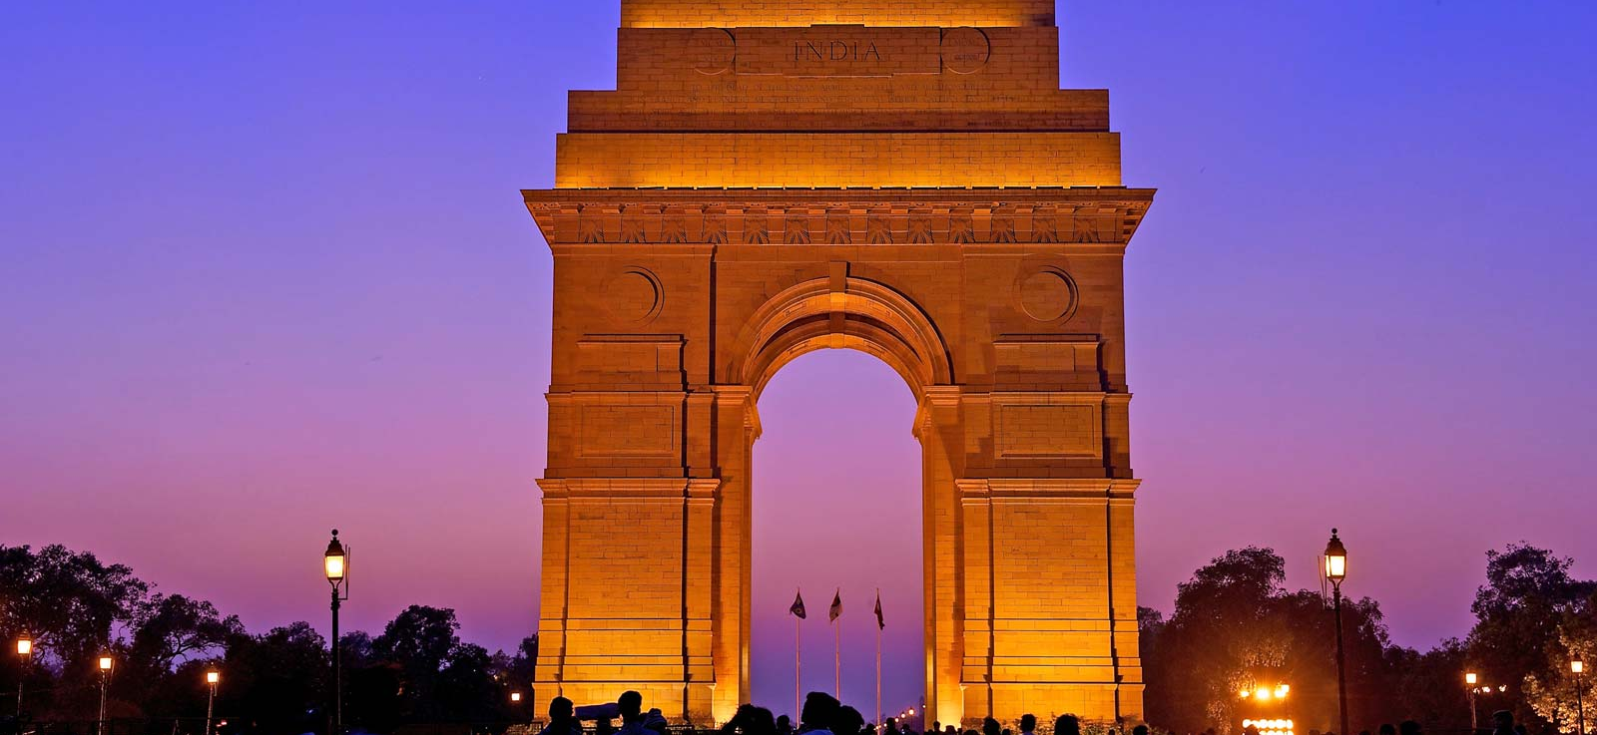
Delhi
Delhi, India’s capital territory, is a massive metropolitan area in the country’s north. In Old Delhi, a neighborhood dating to the 1600s, stands the imposing Mughal-era Red Fort, a symbol of India, and the sprawling Jama Masjid mosque, whose courtyard accommodates 25,000 people. Nearby is Chandni Chowk, a vibrant bazaar filled with food carts, sweets shops and spice stalls.

Slide 5
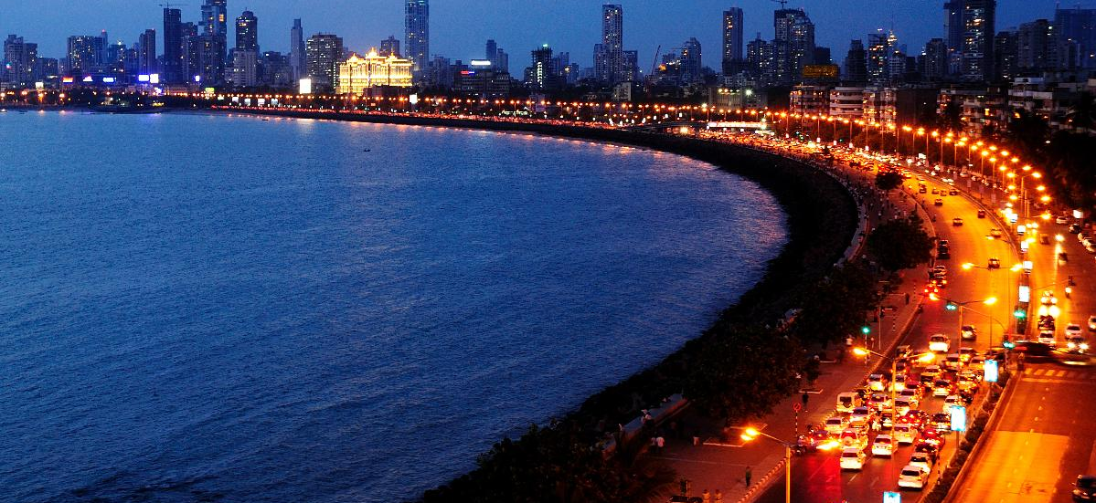
Mumbai
Mumbai (formerly called Bombay) is a densely populated city on India’s west coast. A financial center, it's India's largest city. On the Mumbai Harbour waterfront stands the iconic Gateway of India stone arch, built by the British Raj in 1924. Offshore, nearby Elephanta Island holds ancient cave temples dedicated to the Hindu god Shiva. The city's also famous as the heart of the Bollywood film industry.

Slide 6
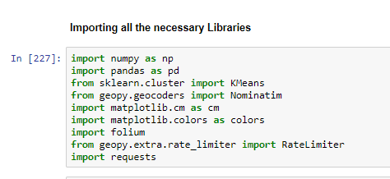
Libraries Used

Slide 7
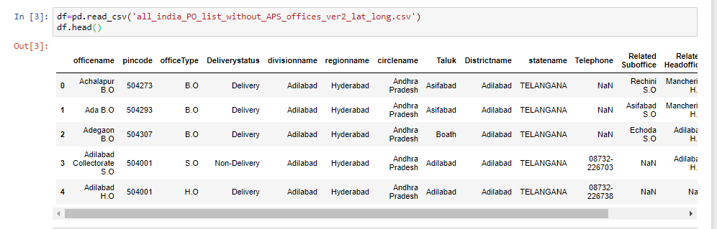
Dataframe

Slide 8
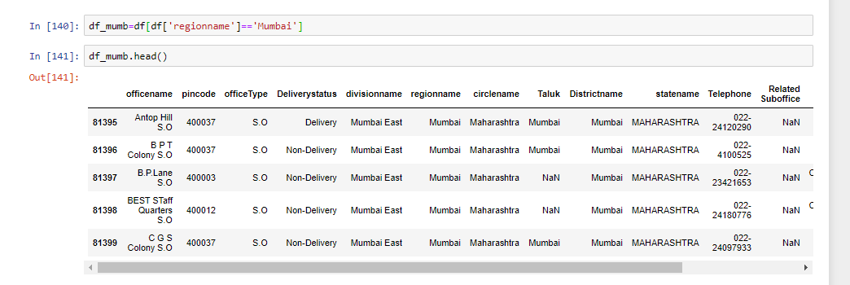
Mumbai Dataframe

Slide 9
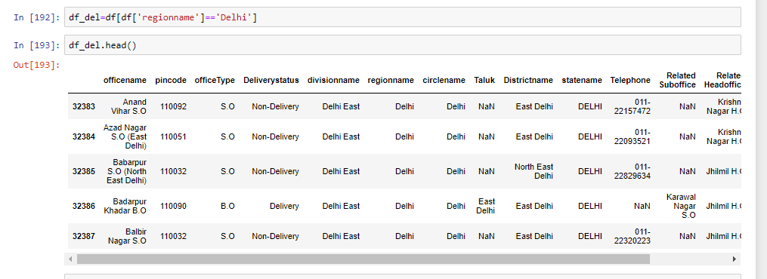
Delhi Dataframe

Slide 10
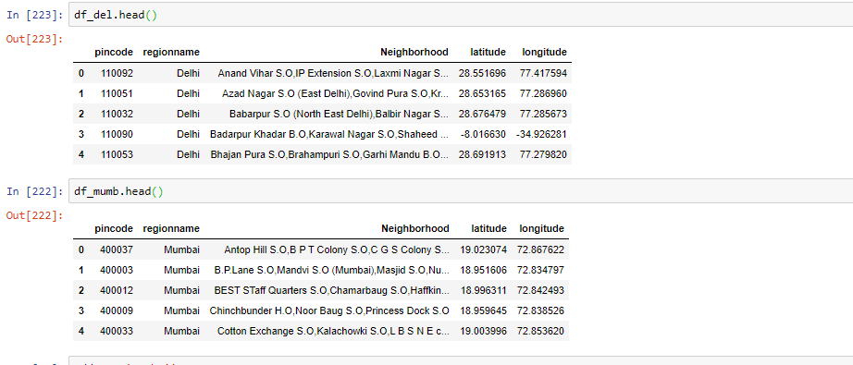
Final Dataframe after removing and adding Necessary Columns

Slide 11
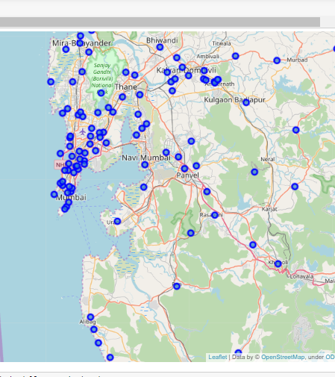
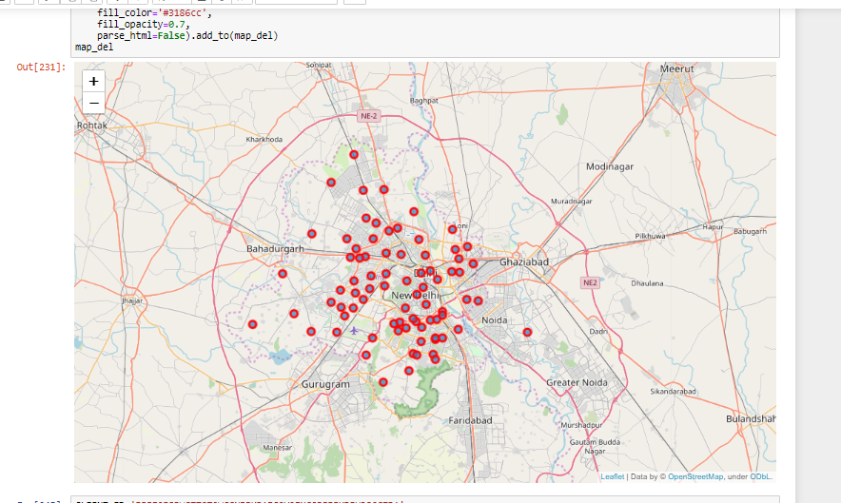
Maps of Delhi and Mumbai Before Clustering
Mumbai
Delhi

Slide 12
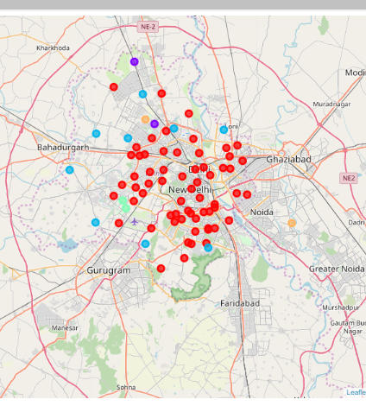
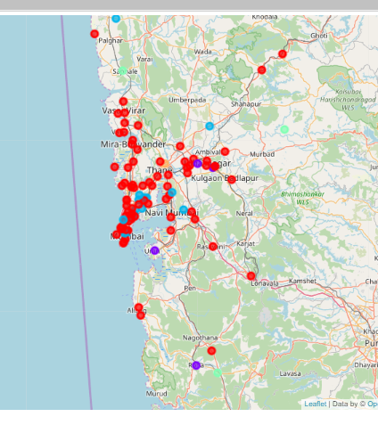
Maps of Delhi and Mumbai After Clustering
Delhi
Mumbai

Slide 13
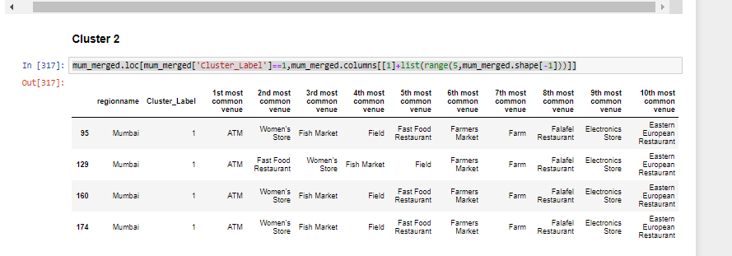
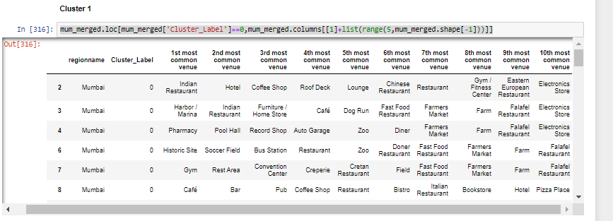
CLUSTERS OF MUMBAI

Slide 14
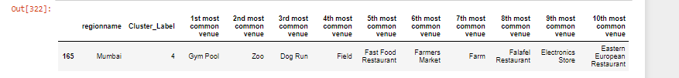
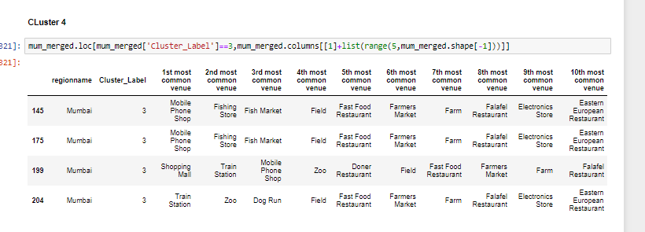
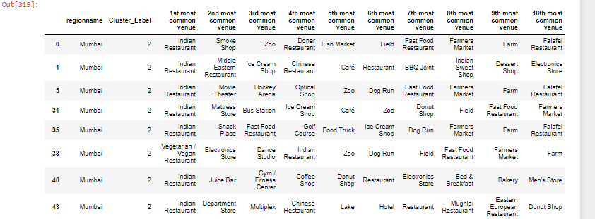
CLUSTERS OF MUMBAI

Slide 15
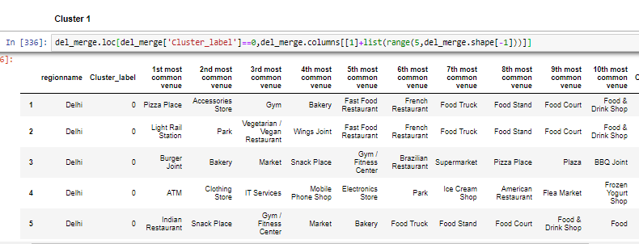
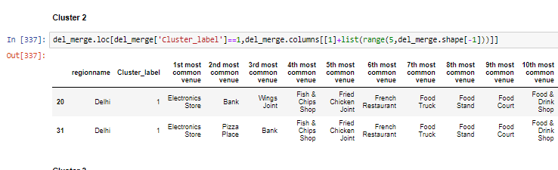
CLUSTERS OF DELHI

Slide 16
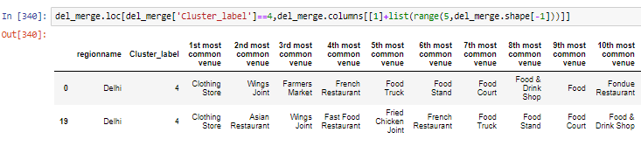
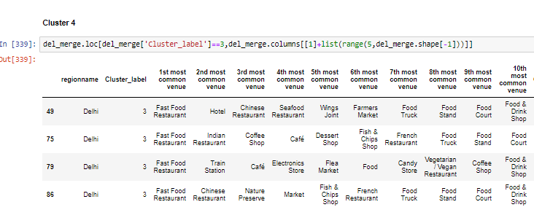
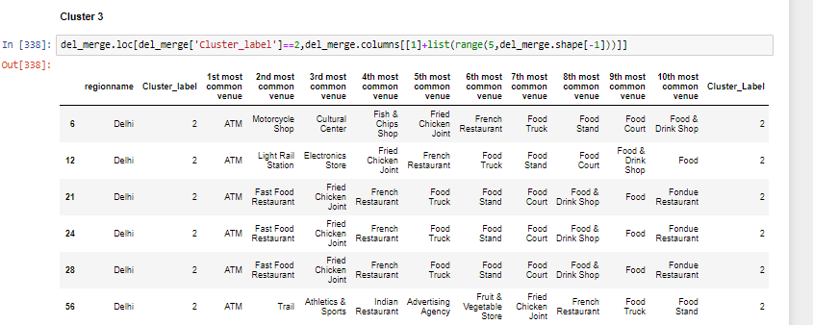
CLUSTERS OF DELHI

